Slide 1
MODULE - III
Compensation and Benefits:
Introduction, Definitions, Total Compensation, Total Rewards System, Forms of Pay, External and Internal Factors, Establishing Pay Rates, Employee Benefits.
Performance Management and Appraisal:
Objectives of Performance Management, Performance Management and Performance Appraisal, Common Problems with Performance Appraisals, Performance Management Process, Types of Performance Rating Systems, Future of Performance Management.
Industrial Relations:
Decent Workplace, International Labor Organisation, Industrial Relations, The Objectives of Industrial Relations, Approaches of Industrial Relations Systems, The Actors in Industrial Relations, Indian Context, Industrial Relations and Human Resource
Management.

Slide 2
COMPENSATION AND BENEFITS
Compensation and benefits are the key factors in attracting and keeping the best human capital and ensuring that organization has the competitive edge in the increasing competitive world.
It is an Integral part of human resource management which helps in motivating the employees and improving organizational effectiveness.

Slide 3
It is a total of all rewards and recognisation provided to employees by the employers in returns to their mental and physical sacrifice to the betterment of the company.
It is a systematic approach to providing monitory and non- monitory values / benefits to employees in exchange for work performed.

Slide 4
TYPES OF COMPENSATION SYSTEM
Basic Pay
Direct Pay
Variable Pay
Financial Benefits
Indirect Pay
Protection (Insurance ) Programs
Pay for time not worked.
2. Non - Financial Benefits
Praises and Rewards
Satisfaction Derived

Slide 5
FACTORS AFFECTING COMPENSATION SYSTEM
Internal Factors | External Factors
Ability to Pay | Labour Market
Compensation Policy | Going Rate
Job Description | Cost of Living
Performance Appraisal | Labour Unions
Employee | Labour Laws.
 | Legal Requirements.

Slide 6
Employee Benefits
Employee Benefits, also known as perks or fringe benefits, are provided to employees over and above salaries and wages. These are the Job and Career related benefits. Includes :
Achievements, Awards and Recognition.
Social Security.
Perks and Bonuses.
Pay Rises.
Employees Allowances.
Protection Allowances(Health Insurance).
Paid Vacation.
Sufficient Meal Breaks.

Slide 7
Performance Management &Appraisal
Performance Management is a continuous and systematic approach that ensures the achievement of organizational business goals by streamlining employee performance and efforts to match the set goals efficiently.
Performance Appraisal is a process for evaluating and documenting how well an employee is carrying out his or her job. Performance appraisals are based on the employee's progress against goals set once a year with his or her manager.

Slide 8
Objectives of Performance Management
Develop clear role definitions, expectations and goals.
Increase employee engagement.
Develop managerial leadership and coaching skills.
Boost productivity through improved performance.
Develop a performance reward program that incentivizes accomplishment.

Slide 9
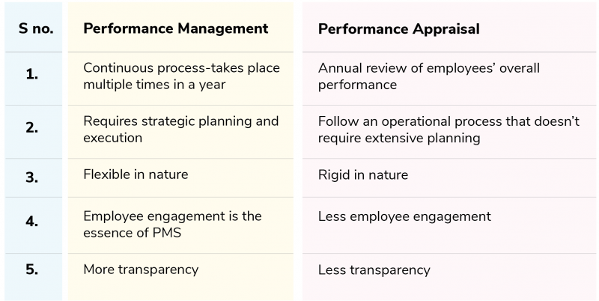
P. Management v/s P. Appraisal

Slide 10
Common Problems with P. Appraisals
Manager’s judgment or assessment based on preferences.
Unstructured methods of performance appraisal systems.
Lack of interest and ownership of manager.
Lack of a proper channel of communication.
Lack of reward and recognition policy.
Lack of leadership.
Lack of designing, monitoring and measuring the performance appraisal standards.
Lack of communication.
Overemphasizing recent performances.
No recognition/ rewards.

Slide 11
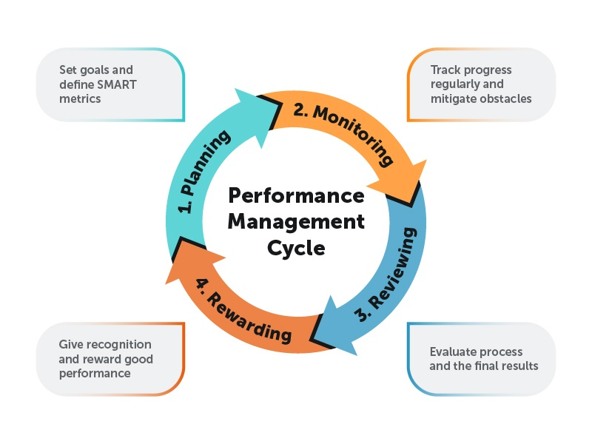
Performance Management Process
Performance Management requires that the manager should define the performance, facilitate performance and encourage performance.

Slide 12
Types of Performance Rating Systems
Performance Appraisal can be broadly classified into two categories. They are :
Traditional Methods:
(Ranking Method , Graphic Rating Scales , Critical Incident Method , Narrative Essays )
2. Modern Methods:
(Management by Objectives , Behaviorally Anchored Rating Scale (BARS) , Humans Resource Accounting , Assessment Centers , 360 Degree ).

Slide 13
1. Ranking Method :
According to Dessler et al. (2011), ranking method is ranking employees from best to worst on a particular trait, choosing highest, then lowest, until all ranked.
2.Graphic Rating Scales :
According to Dessler et al. (2011), Graphic Rating Scale is a scale that lists a number of traits and a range of performance for each. The employee is then rated by identifying the score that best describes his or her level of performance for each trait.

Slide 14
3. Critical Incident Method
According to Dessler et. al.(2011),Critical Incident method is keeping a record of uncommonly good or undesirable examples of an employee’s work related behavior and reviewing it with the employee at predetermined times.
4. Narrative Essays :
This technique mainly attempt to focus on behavior. Evaluator writes an explanation about employee’s strength and weakness points, previous performance, positional and suggestion for his (her) improvement at the end of evaluation time.

Slide 15
1. Management by Objectives:
Management by objectives (MBO) is the appraisal method where managers and employees together identify, plan, organize, and communicate objectives to focus on during a specific appraisal period.
2. Behaviorally Anchored Rating Scale (BARS) :
Behavioral anchor scales are more informative than simple numbers. BARS is a tool for evaluating employees in a defined set of performance dimensions by comparing their behaviors with specific behavior examples that anchor each performance level, usually on a five-, seven- or nine-point scale.

Slide 16
3. Humans Resource Accounting :
HRA is the process of Assigning, budgeting, and reporting the cost of human resources incurred in an organization, including wages and salaries and training expenses.
It analyses an employee's performance through the monetary benefits he/she yields to the company. It is obtained by comparing the cost of retaining an employee (cost to company) and the monetary benefits (contributions) an organization has ascertained from that specific employee

Slide 17
4. Assessment Centers :
Under this an employee is evaluated on critical competencies necessary for their job using job-related simulations and exercises.
5. 360 Degree :
It involves evaluation input from multiple levels within the firm as well as external sources.360 Degree feedback relies on the input of an employee’s superior, colleagues, subordinates, sometimes customers, suppliers and/or spouses.
It provides people with information about the effect of their action on others in the workplace

Slide 18
Future of Performance Management
The end of the annual review ( Continuous Performance Reviews Are the New Normal).
The future lies in tech (AI-Powered Performance Insights & Predictive Analytics).
An equitable system.
Linking Performance with Well-Being.
Transparent & Data-Driven Evaluation Systems.
Multi-Dimensional Feedback: 360° Is Here to Stay.

Slide 19
Industrial Relations
Decent Workplace, International Labor Organisation, Industrial Relations, The Objectives of Industrial Relations, Approaches of Industrial Relations Systems, The Actors in Industrial Relations, Indian Context, Industrial Relations and Human Resource Management.

Slide 20
Decent Work
As per ILO Decent work sums up the aspirations of people in their working lives. It involves :
1.Opportunities for work that is productive and delivers a fair income.
2. Security in the workplace and social protection for all.
3.Better prospects for personal development and social integration.
4.Freedom for people to express their concerns, organize and participate in the decisions that affect their lives.
5.Equality of opportunity and treatment for all women and men.

Slide 21
The International Labour Organization (ILO)
The International Labour Organization (ILO) is devoted to promoting social justice and internationally recognized human and labour rights, pursuing its founding mission that social justice is essential to universal and lasting peace.
The only tripartite U.N. agency, since 1919 the ILO brings together governments, employers and workers of 187 Member States, to set labour standards, develop policies and devise programmes promoting decent work for all women and men.

Slide 22
ILO : Objectives
The ILO is a meeting point for governments, workers and employers of ILO’s member States to set labour standards, improve upon policies and create programs that promote decent work for people. The four strategic objectives at the heart of the Decent Work agenda are:
To develop and effectuate standards, fundamental principles, and fundamental rights at work.
To ensure that men and women have equal access to decent work while enhancing opportunities for the same.
To magnify the coverage and effectiveness of social protection for everyone.
To strengthen Tripartism and social dialogue.

Slide 23
MEANING
It is in the interest of everyone to create and maintain good relations between Employees and Employees.
According to Dale Yoder, “ IR refers to the relationship between management and employees or among employees and their organization that arise out of employment”.
Actors/Parties to Industrial Relations :
Employers and their Organization.
Employees and their Organization.
Trade Union.
Government (to protect the interest of both parties).

Slide 24
Objectives of IR :
To safeguard the interest of labour as well as management.
To raise productivity to the higher level.
To ensure industrial peace by eliminating the industrial disputes.
To establish and maintain the industrial democracy by WPM.
To reduce the labour turnover and absenteeism by providing Job Satisfaction.
To eliminate the Strikes, Lockouts, Gheraos etc by ensuring reasonable Wages and Fringe benefits.
To encourage and develop the Trade Union .
To ensure a healthy and balanced social life.

Slide 25
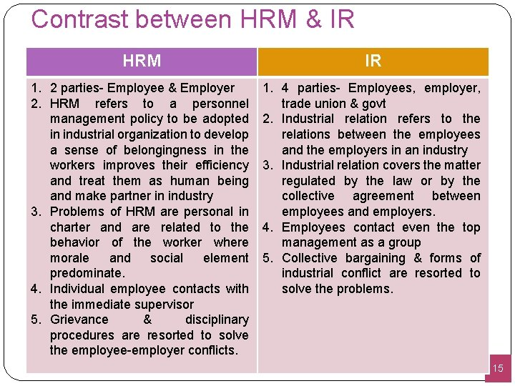
HRM And Industrial Relations

Slide 26
Approaches to Industrial Relations
The four popular approaches to industrial relations are :
1. The Unitary Approach.
2. Pluralistic Approach.
Marxist/ Radical Approach.
System Approach.

Slide 27
1. The Unitary Approach
Unitary Perspective of Industrial Relations views the industrial organization as an entity unified by one aim, and that is success. In unitarism, the organization is perceived as an integrated and harmonious system, viewed as one happy family.
As per this approach, Management reserve the right to manage and take decisions. And it is considered as legitimate, rational and accepted. And opposition to decision is considered as irrational.

Slide 28
2. Pluralistic Approach
This approach perceives organization as a coalition of competing interest between management and different groups, trade unions as legitimate representative of employee's interests and stability in Industrial Relation as the product of concessions and compromises between management and workers.
This approach believes that trade unions are legitimate representatives of employee interest and management authority is nor automatically accepted.

Slide 29
3. Marxist/ Radical Approach
Marxist approach is based on the proposition that the economic activities of production, manufacturing, and distribution are majorly governed by the objective of profit.
It also regard that conflict between employers and employees as inevitable.
This approach is based on the class conflict between have and have nots, controlled and controller, exploiter and exploited.

Slide 30
4. System Approach
As for this , individuals are part of an ongoing but independent social system. The behaviour, actions and role of the individuals are shaped by the cultures of the society.
As per this, IR system defines, at any one time in its development is regarded as comprised of certain actors, certain contexts and an ideology that finds the IR system together, and a body of rules created to govern the as actors at the workplace and the work community.

Slide 31
Module IV
Human Resource Management in Small and Medium Enterprises: Introduction to SMEs, The Difference in Adoption of Human Resource Management, SMEs and Large Firms, Indian Experience, Impact of Weak Adoption of Human Resource Management in SMEs,
Human Resource Management in the Service Sector: Introduction, The Emergence of the Services Sector, Implications for Human Resource, Management Function, Differences Between Services Sector and the Manufacturing Sector, Difference in Human Resource Management in Services and Manufacturing Sectors, Human Resource Management and Service Quality Correlation, Trade Unions in Services Sector, Models of Union Strategies.

Slide 32
HRM in Small and Medium Enterprises
What is MSM Enterprises ??
Micro | Small | Medium
Investment in Plant and Machinery or Equipment: Not more than Rs. 2.5 crore and Annual Turnover not more than Rs. 10 crore | Investment in Plant and Machinery or Equipment: Not more than Rs. 25 crore and Annual Turnover not more than Rs. 100 crore | Investment in Plant and Machinery or Equipment: Not more than Rs. 125 crore and Annual Turnover not more than Rs. 500 crore

Slide 33
Differences in HRM
Small Scale Industries | Large Scale Industries
These have more Non-Structured recruitment practices | These have more Structured recruitment practices
Negligible level of overall HRM sophistication. | Higher level of overall HRM sophistication.
Fewer probabilities for formal training for both managers and employees | Structured Training and Development practices were carried out.
Have less formalized performance appraisals, less likelihood of bonuses based on company productivity | Have formalized performance appraisals, less likelihood of bonuses based on company productivity
Provide more power to the managers, making the managerial prerogative largely unrestricted. | Power to make decision is limited the managers

Slide 34
Impact of Weak Adoption of HRM in SME
Hiring new employees is a major time and financial commitment for a small business.
Don't have the time to properly train new hires.
Managing payroll and filing taxes can be a time-consuming and challenging task.
Poor Employee benefits Scheme.
it is difficult for small businesses to retain quality employees.

Slide 35
HRM in the Service Sector
Service can be defined as the production of intangible benefits and experience, either alone or as part of a tangible product, through some form of exchange, with the intention of satisfying the needs, wants and desires of the consumers.
According to Philip Kotler “A Service is an act of performance that one party can offer to another that is essentially intangible and does not result in the ownership of anything. Its production may or may not be tied to a physical product.”
In short, services are deeds, processes and performances.

Slide 36
Services Sector V/s Manufacturing Sector
Services Sector | Manufacturing Sector
Intangibility | Tangibility
Heterogeneity & Difficult to Standardized | Easy to Standardized
Simultaneous Production and Consumption | Production and Consumption occurs separately.
Perishable | Non-Perishable (Durable)
Ownership can be transferred | Ownership can be transferred

Slide 37
The Emergence of the Services Sector
The service sector in India has the highest employment elasticity among all sectors. Thus, it has the potential for huge growth as well as the capability to deliver highly productive jobs - leading to revenue generation.
India should closely look into the development of the service industry, given the potential and need for sustained large scale investment.
The emerging sector in Indian Economy today are Food Processing, Manufacturing Sector, Health Care, Organized Retailing, Education and Training, Tourism, Entertainment, Insurance, Knowledge Process Outsourcing etc.

Slide 38
HRM in Services Sector V/s HRM in Manufacturing Sector
Major differentiators between the HR of these sectors are:
1) Level of education of employees.
2) Training to represent themselves in the company's desired profile.
3) Customer contact (this is also changing due to competition anyway!)
4) The nature of actually performed by the employees and their awareness to customer response.

Slide 39
Human Resource Management and Service Quality Correlation
In the service organization , the key stakeholder is the customer and the key activity is to deliver service of quality .
The very nature of service, that is , their intangibility , poses difficulty in evaluation of quality .
Service organization is “ in need of mechanism by which it can reduce this input of uncertainty and acquire the information necessary for effective service production an delivery “
Sustained quality of service can only happen in a service climate .

Slide 40
Service climate has been defined as employee's perception that :
a) Practices and procedure were in place to facilitate the delivery of excellent service.
b) Management rewarded , supported and expected excellent service .

Slide 41
Models of Union strategies
This framework posits that union strategies can be analyzed in terms of four dimensions: objectives, methods, tactics and the level at which strategies are formulated and implemented.
It also considers the nature of the strategy formulation process.
This model, it is argued, could be operationalised in cross-national research on union strategy to investigate specific strategic patterns, the determinants of specific strategic patterns, and the relationship between different strategies and measures of union effectiveness.

Slide 42
Thank You…..

Slide 43
Future Trends in H R M
Future Trends in Human Resource Management: Hybrid work model, Employee Skill Development, Internal mobility, Diversity and inclusion in workforce, People analytics,
Employee well-being, Multi-generational workforces and All-in-One HR tools.
Introduction to Human Resource Information System (HRIS): The Concept of HRIS, The role of IT, Database concepts and applications in HRIS, Steps in implementing an HRIS, Benefits and limitations of HRIS.

Slide 44
Future Trends in Human Resource Management
HRM is continually evolving to adapt to changes in the workplace, technology, and society. To stay competitive and effectively manage human capital, HR professionals must anticipate and embrace emerging trends.
Hybrid Work Model
(Remote Work Infrastructure, Well-being and Mental Health, Cost Management, Employee Engagement).

Slide 45
2. Employee Skill Development
( Assessment of Skill Gaps ,Training and Development Programs ,Individual Development Plans (IDPs) ,Mentorship and Coaching ,Feedback and Performance Reviews ,Collaboration and Knowledge Sharing, Continuous Learning Culture, Recognition and Rewards).
3. Internal Mobility :
Internal talent mobility or career development within an organization, is a strategic HRM concept that focuses on facilitating the movement of employees within the company to various roles, departments, or locations.
(Career Development Plans ,Skill Assessments ,Job Postings and Internal Job Boards ,Cross-Training ,Mentorship and Coaching ,Succession Planning ,Feedback and Evaluation )

Slide 46
4.Diversity and Inclusion (D&I) in the Workforce
Diversity and inclusion (D&I) in the workforce refer to the intentional effort to create a workplace environment that values and embraces differences among employees, including those related to race, ethnicity, gender, age, sexual orientation, disability, religion, and more.
It goes beyond compliance with equal opportunity laws and focuses on fostering a culture of respect, fairness, and equality.
(Innovation, Enhanced Decision-Making, Employee Engagement, Improved Problem-Solving ,Market Competitiveness)

Slide 47
5. People Analytics
HR analytics or workforce analytics, refers to the use of data and advanced analytical techniques to inform and improve human resource management (HRM) decisions and strategies within an organization.
(Data Collection, Data Analysis, Metrics and KPIs, Employee Engagement, Retention and Turnover Analysis ,Performance Management, Cost Reduction ,Data Governance ,Ethical Considerations ,Continuous Improvement )

Slide 48
6.Employee Well-Being
Employee well-being refers to the physical, mental, and emotional health and happiness of employees within an organization. It encompasses various aspects of an employee's life, both inside and outside of work, that can impact their overall well-being and job performance.
(Physical Well-being, Mental and Emotional Well-being, Financial Well-Being, Social Well-being ,Workplace Policies ,Communication and Support, Recognition and Appreciation, Feedback and Surveys)

Slide 49
7.MULTI-GENERATIONAL WORKFORCE
Multi-Generational workforce consists of employees from various age groups, spanning different generations, such as Baby Boomers (Born 1946-1964), Generation X (Born 1965-1980), Millennials (Born 1981-1996), and Generation Z (Born 1997-Present)
Each generation brings its unique perspectives, values, work styles, and communication preferences to the workplace.
(Understanding Generational Differences, Communication, Feedback and Recognition, Technology and Tools, Work-Life Balance, Career Development, Mentorship and Knowledge Transfer, Benefits and Perks, Continuous Learning)

Slide 50
8. ALL-IN-ONE HR TOOLS (HRMS)
Also known as integrated Human Resource Management Systems (HRMS) or Human Capital Management (HCM) platforms, are comprehensive software solutions designed to streamline and centralize various HR functions within an organization. These tools consolidate HR processes, data, and functions into a single platform, providing HR professionals with a more efficient and holistic way to manage their workforce.
(Core HR Management, Recruitment and Applicant Tracking, Employee Self-Service (ESS), Time and Attendance, Payroll and Compensation Management, Benefits Administration, Performance Management, Workforce Analytics and Reporting, Employee Engagement and Surveys).

Slide 51
HRIS
A Human Resources Information System (HRIS) is a software solution used to manage and automate various HR processes within an organization.
It centralizes employee data, streamlines HR tasks, and facilitates more efficient decision-making. Essentially, it's a digital platform for managing all aspects of the employee lifecycle, from recruitment to retirement.

Slide 52
Key Aspects or Elements of an HRIS
Centralized Data Management.
Improved Efficiency.
Data-Driven Decision Making.
Enhanced Employee Experience.
Automation of Processes.
Reporting and Analytics.
Performance Management.

Slide 53
Steps in Implementing an HRIS
Planning and Preparation.
(Goals and Objectives, Budget and Timeline)
Vendor Selection.
(Research and Shortlist Vendors, Negotiate Contracts and Agreements)
System Configuration.
(Tailor the System, Set up Security Protocols)
Data Migration.
(Clean and Validate Existing Data, Migrate Data to the New System)
Testing and Training.
(Conduct Thorough Testing, Offer Different Training Methods:)
Go-Live and Evaluation

Slide 54
Benefits of HRIS
Increased Efficiency.
Better Decision Making.
Improved Data Management.
Enhanced Compliance.
Improved Employee Experience.
Streamlined Processes.

Slide 55
Limitations of HRIS :
High Initial Costs.
Potential Security Risks.
Data Entry Errors.
Reliance on Technology.
Limited Support for Strategic Initiatives.
Integration Challenges.
Potential for User Adoption Issues

